Slide 1
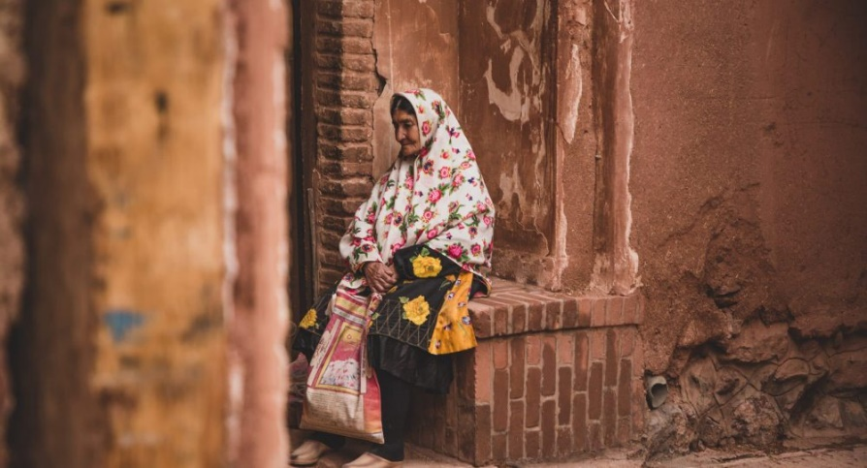

Slide 2
“You must not mistreat or oppress foreigners in any way. Remember, you yourselves were once foreigners in the land of Egypt.”
Exodus 22:21

Slide 3
Hospitality = Philoxenia
Philo =
love
Xenia =
the other
“Friend to the Stranger”

Slide 4
God Loves the stranger.

Slide 5
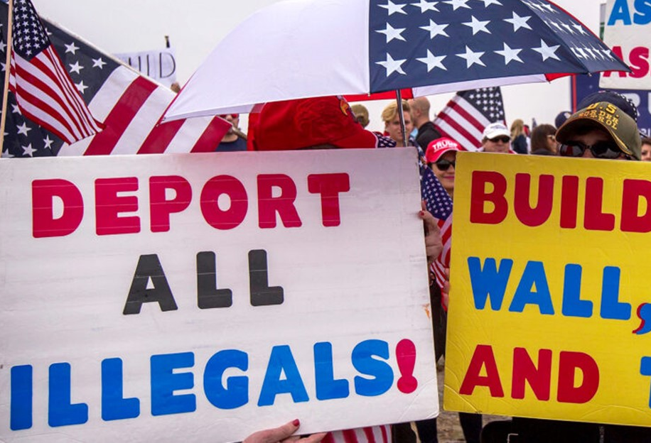
Some fear the stranger.

Slide 6
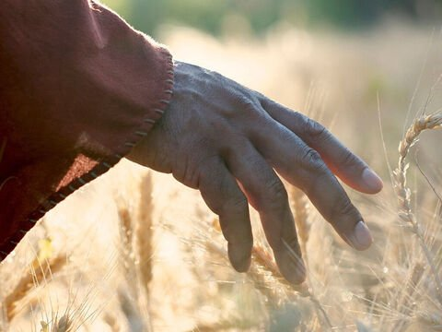
Lord
of the
Sabbath

Slide 7
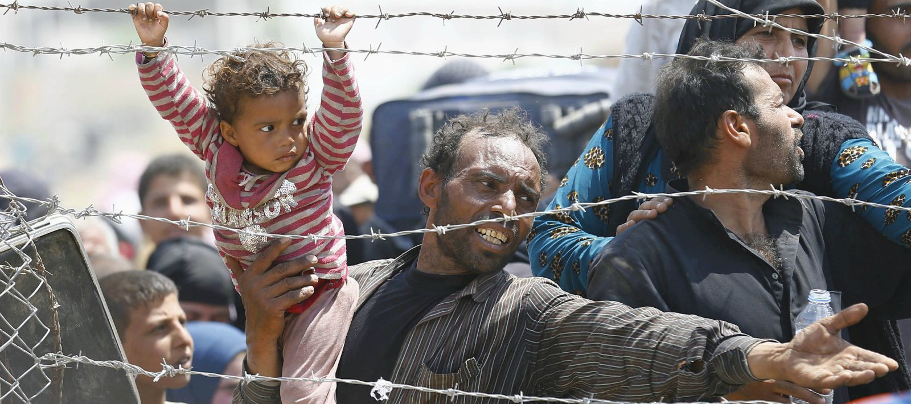
Lord, when did we ever see you hungry and feed you?

Slide 8
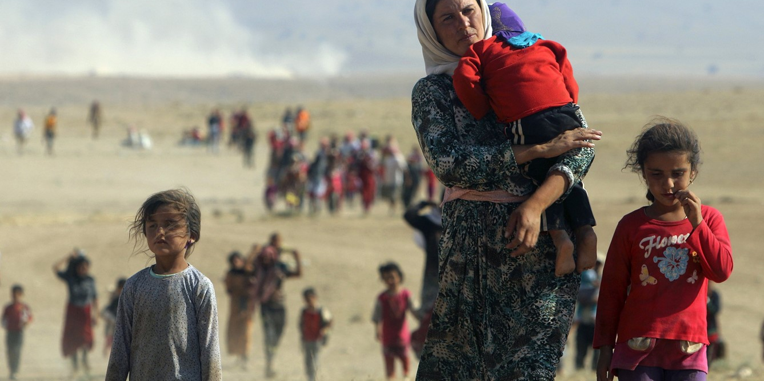
…or thirsty and give you something to drink?

Slide 9
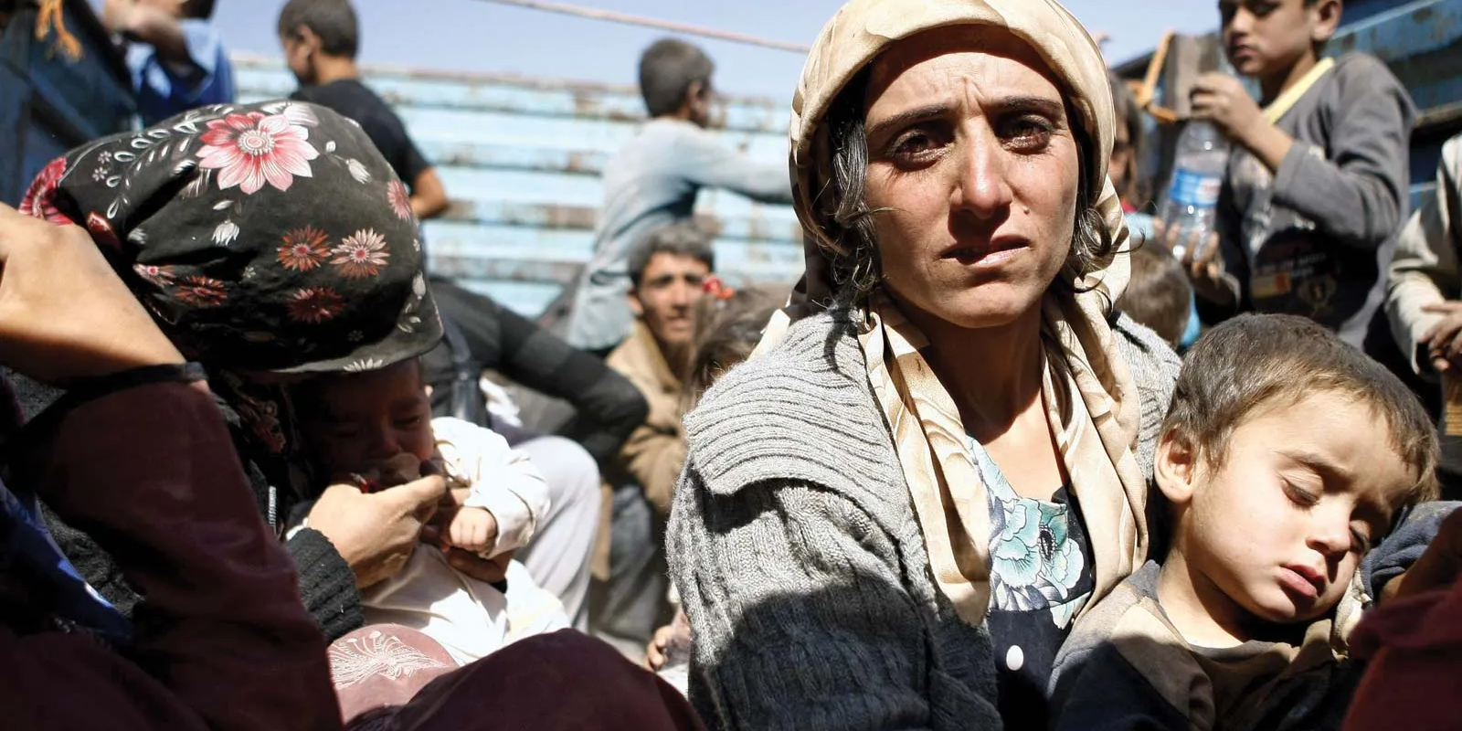
...or a stranger and show you hospitality?

Slide 10
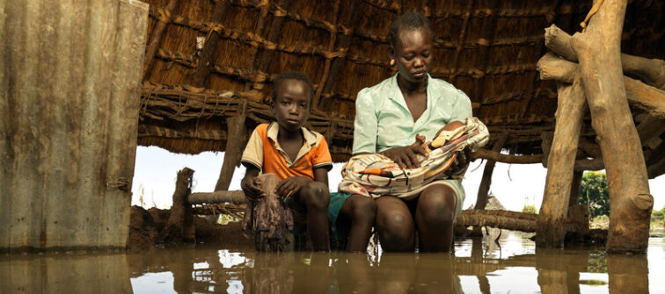
Or naked and give you clothing?

Slide 11
When did we
ever see you sick or
in prison
and visit you?

